Slide 1
Welcome to the
Mount Auburn
Practice Improvement Program Community Learning Session
Please be sure to sign in!

Slide 2
Understanding and Preventing Diagnostic Errors in Medicine
Mount Auburn Practice Improvement Program
March 4, 2016
Gordon Schiff MD
Associate Director Center for Patient Safety Research and Practice
Brigham and Women's Hospital Div. General Medicine
Safety Director – Harvard Center for Primary Care
Academic Innovations Collaborative
Associate Professor of Medicine Harvard Medical School

Slide 3
Financial Conflicts/Disclosures
Commercial
  None related (Medware data-mining project)
Other/Grant Funding
  AHRQ PROMISES Ambulatory Safety & Malpractice
  AHRQ –CERT: BWH CERT HIT – Drug Reaction detection
  Chicago (UIC/NW) Patient Safety CERT
  FDA - CPOE Errors Evaluation (CPOEMS)
  CRICO –Diagnostic Errors/Pitfalls Grant
  Gold / Leape Foundation- Boundaries Issues

Slide 4
Learning Objectives
As a result of participating in this session, learners will be able to:
Describe the key drivers of diagnostic failure
Explain how cognitive error contributes to late or incorrect diagnoses
Identify practical strategies to prevent diagnostic error in the ambulatory setting

Slide 5
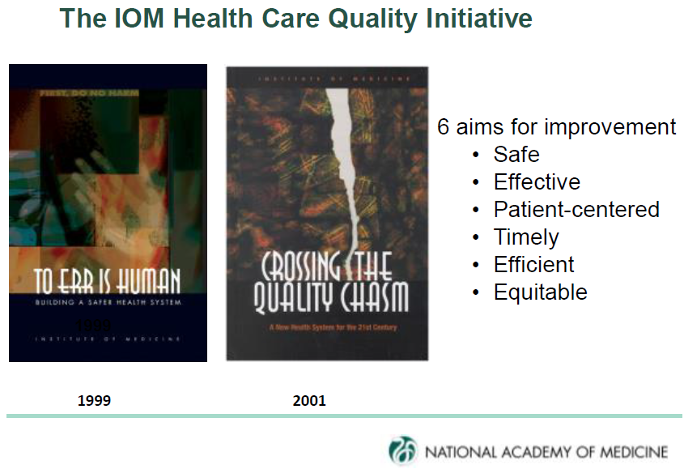
IOM Quality Reports

Slide 6

IOM Report September 2015

Slide 7
8 IOM Goals to Improve Diagnosis and Reduce Diagnostic Error
GOAL 1 | Facilitate more effective teamwork in the diagnostic process among health care professionals, patients, and their families
GOAL 2 | Enhance health care professional education and training in the diagnostic process
GOAL 3 | Ensure that health information technologies support patients and health care professionals in the diagnostic process
GOAL 4 | Develop and deploy approaches to identify, learn from, and reduce diagnostic errors and near misses in clinical practice

Slide 8
8 IOM Goals to Improve Diagnosis and Reduce Diagnostic Error
GOAL 5 | Establish a work system and culture that supports the diagnostic process and improvements in diagnostic performance
GOAL 6 | Develop a reporting environment and medical liability system that facilitates improved diagnosis through learning from diagnostic errors and near misses
GOAL 7 | Design a payment and care delivery environment that supports the diagnostic process
GOAL 8 | Provide dedicated funding for research on the diagnostic process and diagnostic errors

Slide 9

Don Berwick
Formerly –
President and CEO
Institute for Healthcare Improvement (IHI)
Director Centers for Medicare & Medicaid Services
MA Governor Candidate
9

Slide 10

Genius diagnosticians make great stories, but they don't make great health care.
The idea is to make accuracy reliable,
not heroic
Don Berwick
Boston Globe 7/14/2002
10
Notes:
10

Slide 11
YOUR PERSONAL
EXPERIENCES

Slide 12
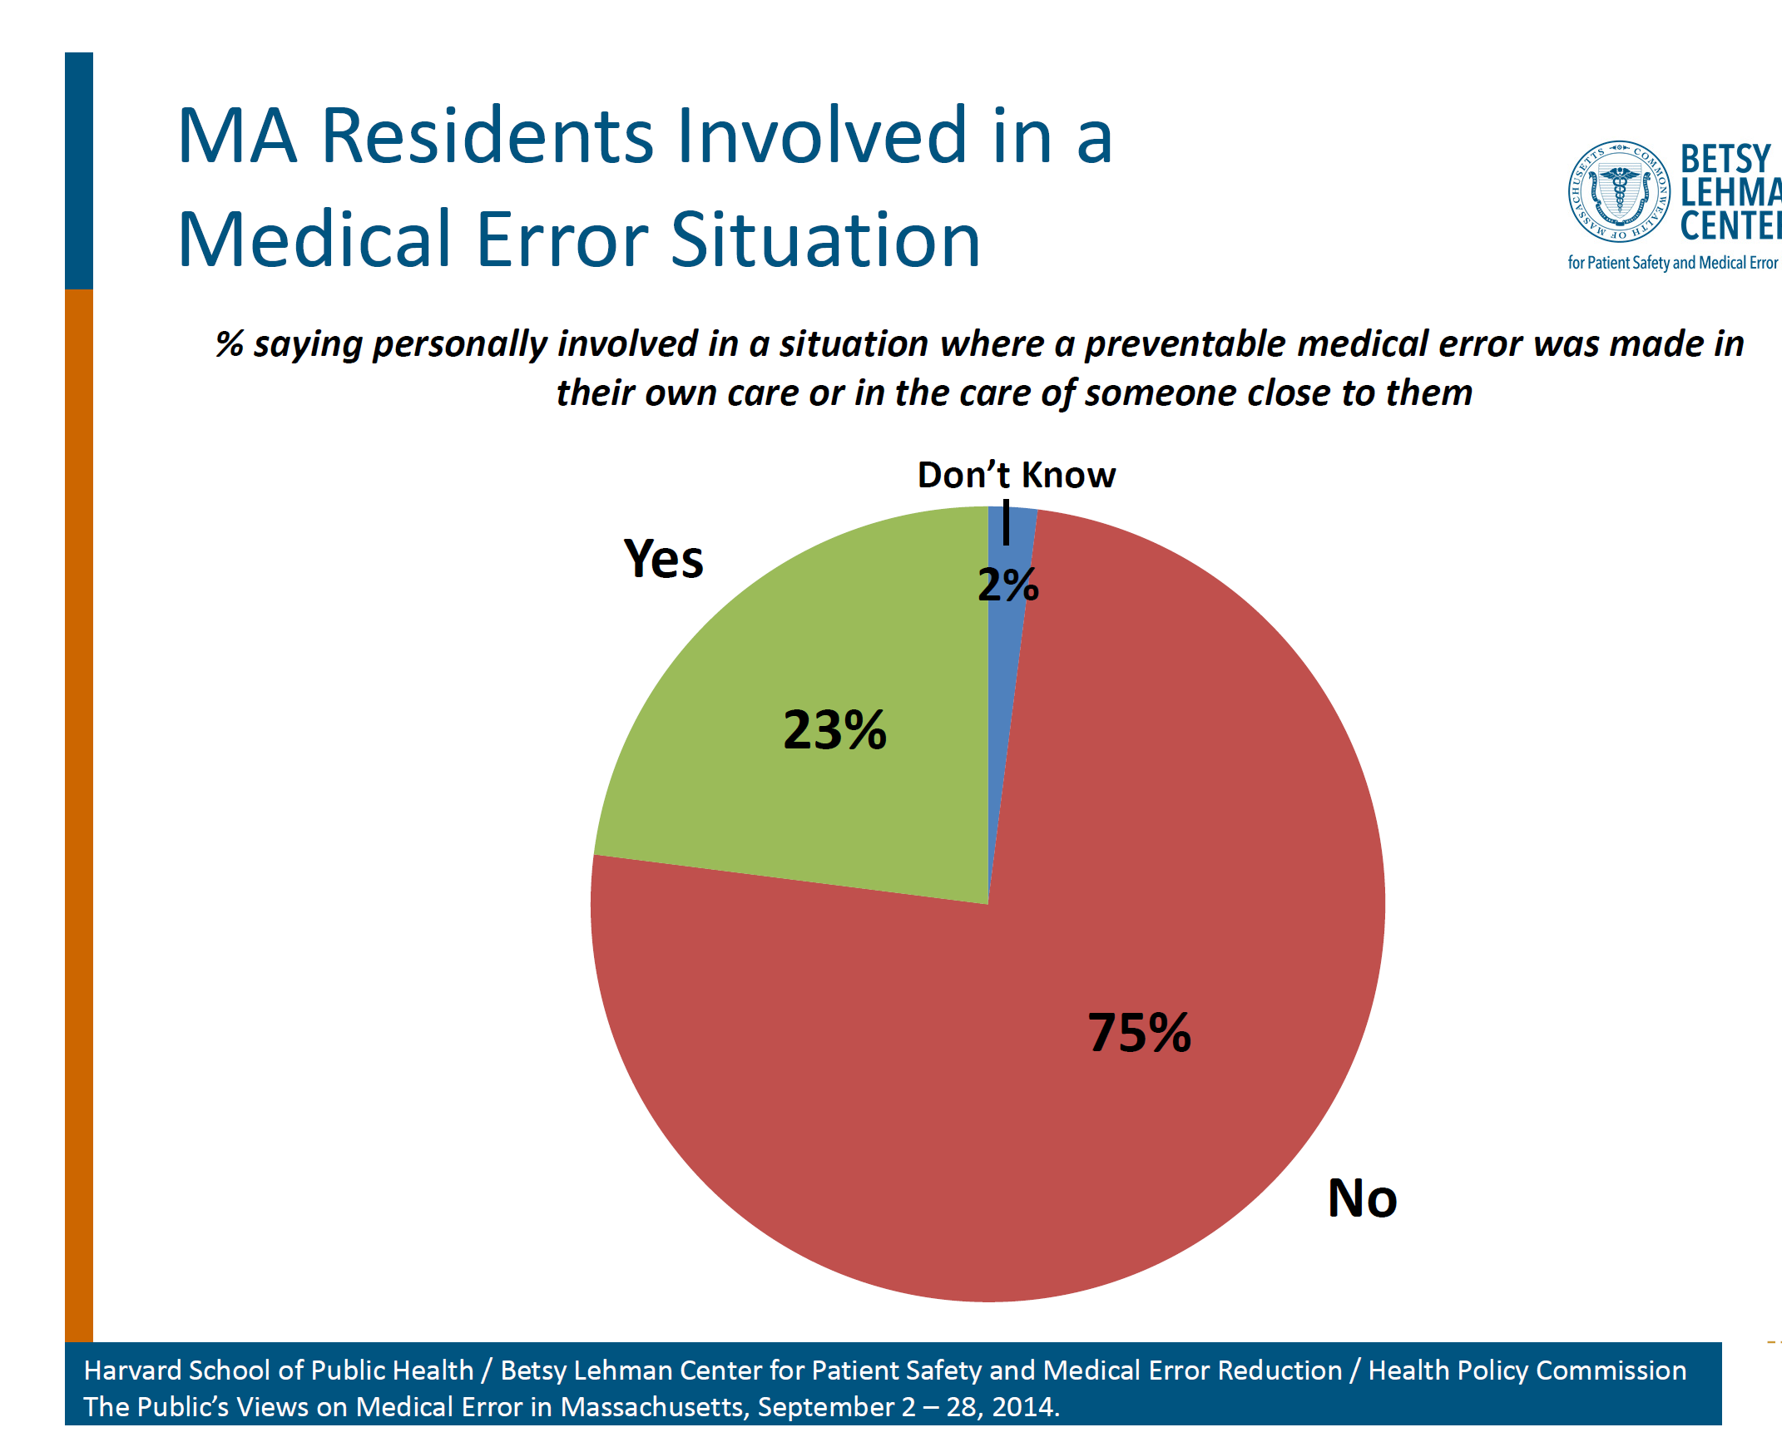

Slide 13
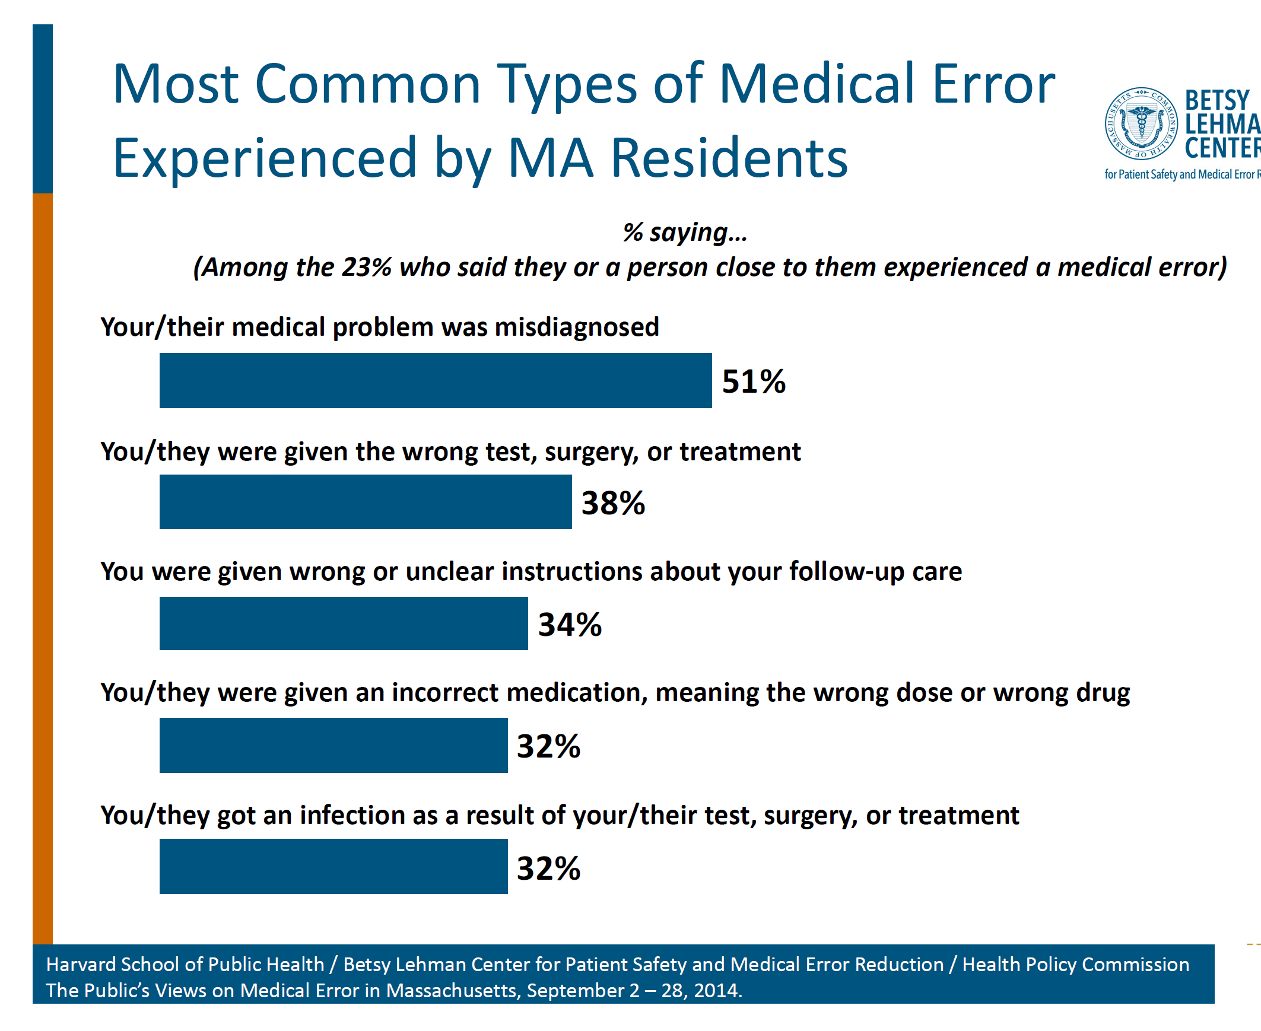

Slide 14
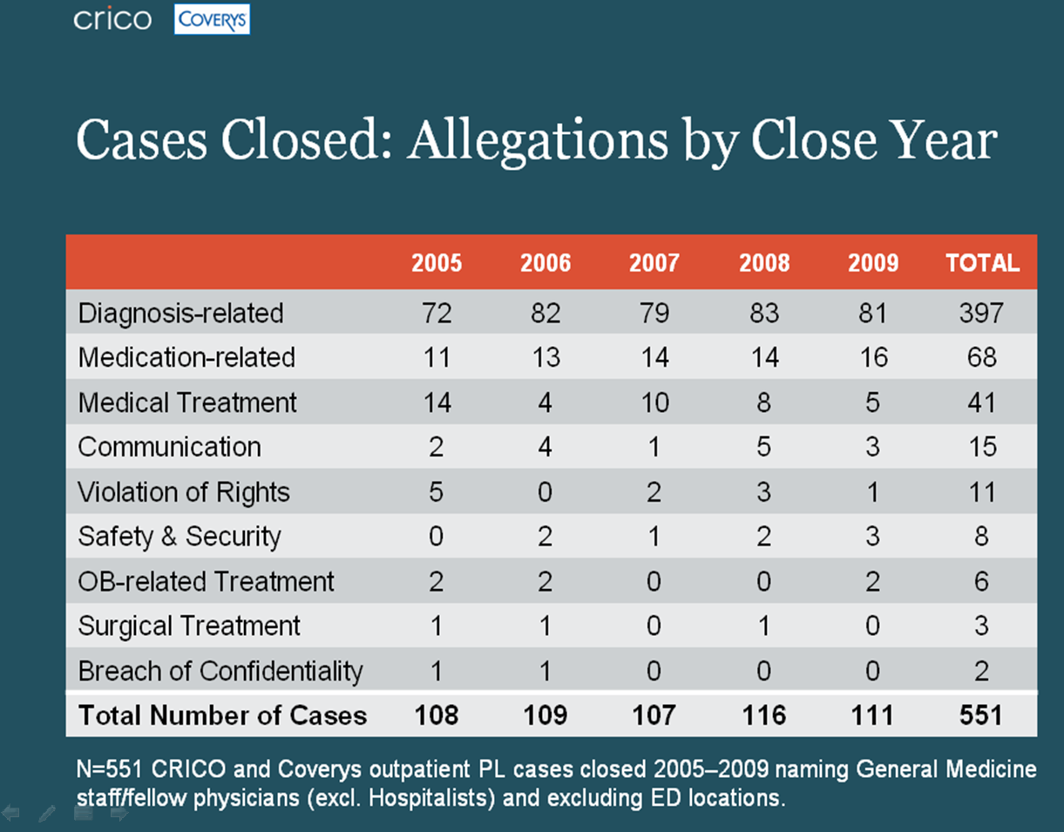
14
Schiff et al JAMA Intern Med 2013

Slide 15
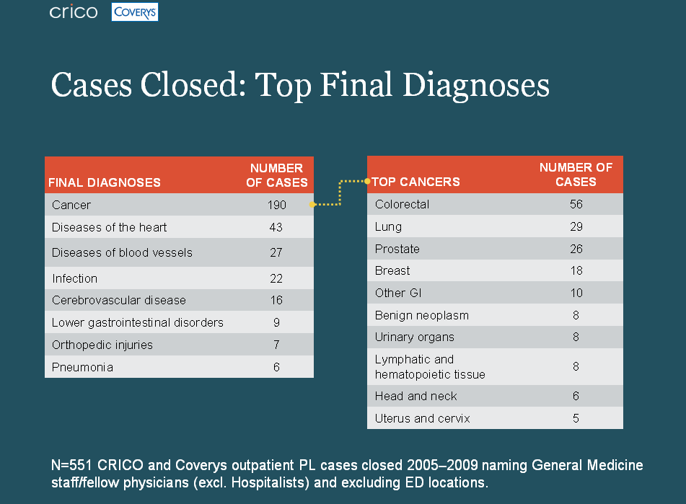

Slide 16
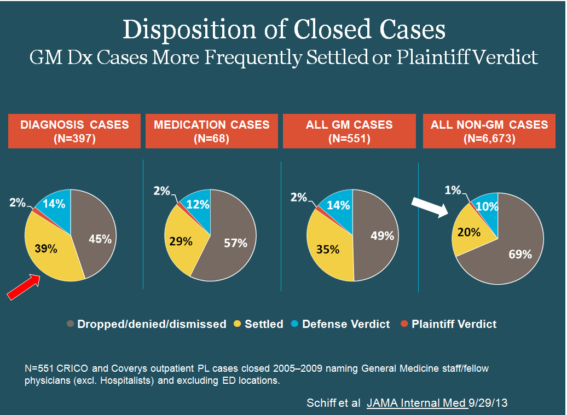

Slide 17
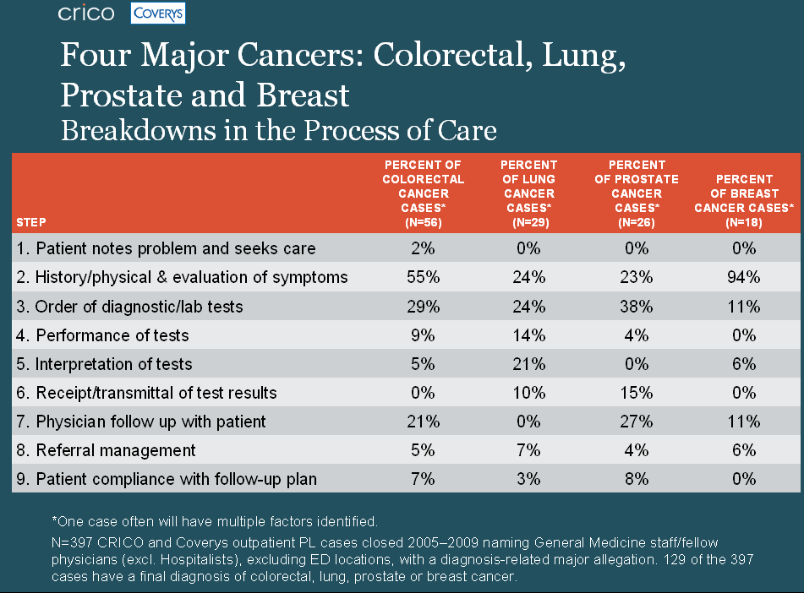

Slide 18
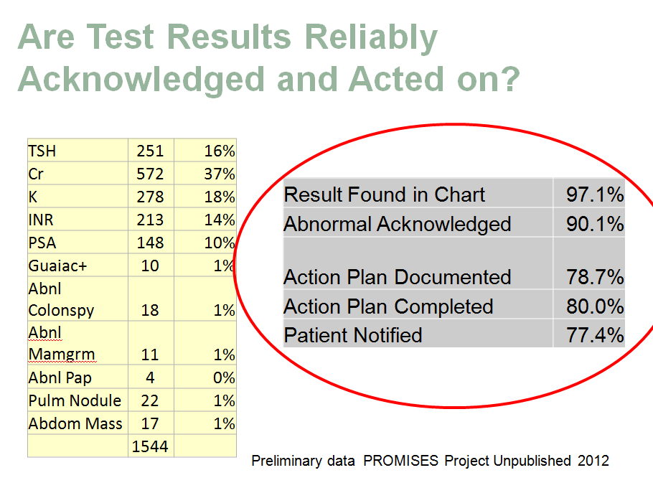

Slide 19
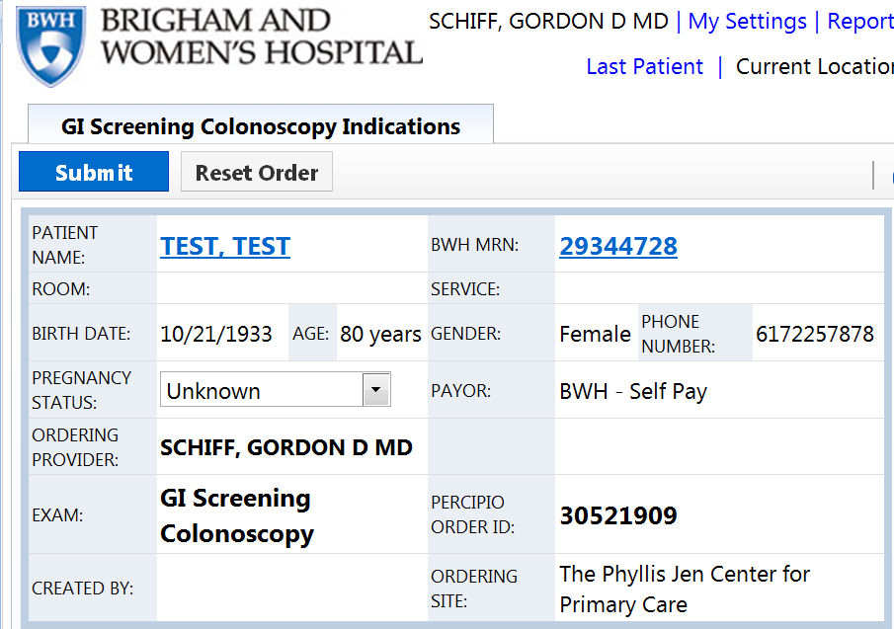
ONLY ~50-50 chance this order results in colonoscopy actually being performed !

Slide 20
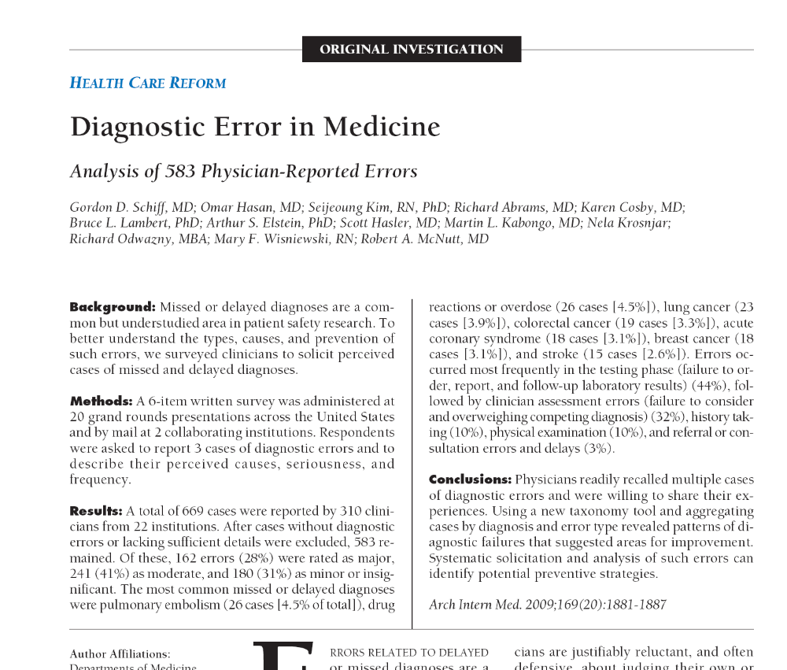

Slide 21
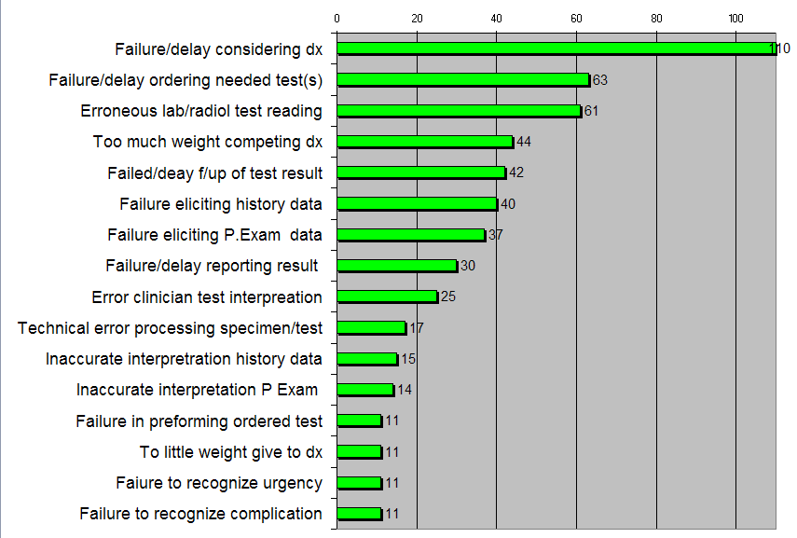
What went wrong: DEER Taxonomy Localization
21

Slide 22
Failure to Consider:
Cognitive vs. System Problem?
Why did clinician fail to consider?
Lack knowledge, memory recall
Inadequate time
Failure to elect key hx or physical
Competing diagnoses, symptoms
Rare, atypical
Tests threw off
Distractions
Biases; heuristic
What are the causes?
What are the remedies?
22

Slide 23
What is a Diagnosis Error?
Adverse
Outcomes
Diagnostic
Process Failures
Delayed,
Missed,
Misdiagnosis
Modified from
Schiff Advances in Patient Safety AHRQ 2005,
Schiff & Leape Acad Med 2012

Slide 24
2 Key Improvement Concepts
Situational Awareness
Safety Nets

Slide 25
Diagnostic Risk
Situational Awareness
Specialized type of situational awareness
High reliability organizations/theory
  High worry anticipation of what can go wrong
  Preoccupied w/ risks recognizing/preventing
Appreciation diagnosis uncertainty, limitations
  Limitations of tests, systems’ vulnerabilities
  Knowing when “over head” need for help
Making failures visible
Don’t miss diagnoses, red flag symptoms
Diagnostic pitfalls – potentially useful construct

Slide 26
Perhaps the most important distinguishing feature of high-reliability organizations is their collective preoccupation with the possibility of failure. They expect to make errors and train their workforce to recognize and recover them. They continually rehearse familiar scenarios of failure and strive hard to imagine novel ones. Instead of isolating failures, they generalize them. Instead of making local repairs, they look for system reforms

Slide 27



Slide 28


Slide 29


What is a Diagnostic Pitfall?
Clinical situations where patterns of, or vulnerabilities to errors leading to missed, delayed or wrong diagnosis

Slide 30
Diagnostic Pitfalls
Overall aim: develop new construct – diagnostic pitfalls – then test ways to electronically screen
Examples of diagnostic pitfalls include:
  Failure to pursue further evaluation of breast lump in light of normal mammogram
  Attributing rectal bleeding to hemorrhoids
  Failure to take seriously symptoms in patient with underlying psychosocial problems
  Stasis dermatitis misdiagnosed as “bilateral cellulitis”

Slide 31
Pitfalls Project: Preliminary Results
Generic Diagnostic Pitfall Paradigms
    -Disease A repeatedly mistaken for Disease B
        Bipolar disease mistaken for depression
    -Failure to appreciate test/exam limitations
        Limitation of CT to diagnose subarachnoid hemorrhage after time
    -Atypical presentation
      Addison’s disease presenting with weight loss, cognitive difficulties, fatigue
    -Presuming chronic disease accounts for new symptoms
        Delay in initiating work-up for clinical clues suggestive of lung cancer in patients with hypertension and COPD
    -Failure to monitor evolving symptom
      Pts w/ subdural hematoma, cranial imagining can be normal shortly after incident, but chronic subdural later develops

Slide 32
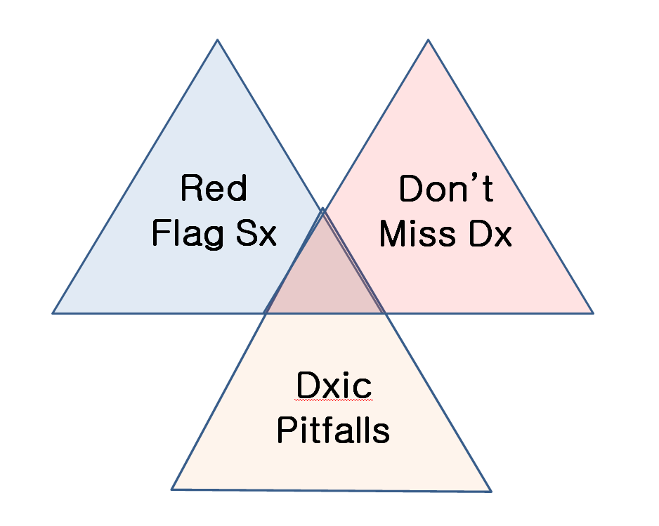
Unified Model of Diagnostic Situational Awareness

Slide 33
Heuristic or Bias
What is difference between a bias and a heuristic
Very efficient mental short-cut that most often gets you to the right diagnosis …
Vs. something that leads you astray, sending down wrong path or causes you to get “stuck” on wrong diagnosis
If "heuristics" is packaged wisdom, then is
"bias" simply short circuited logic?
Evolutionary advantage of bias?

Slide 34
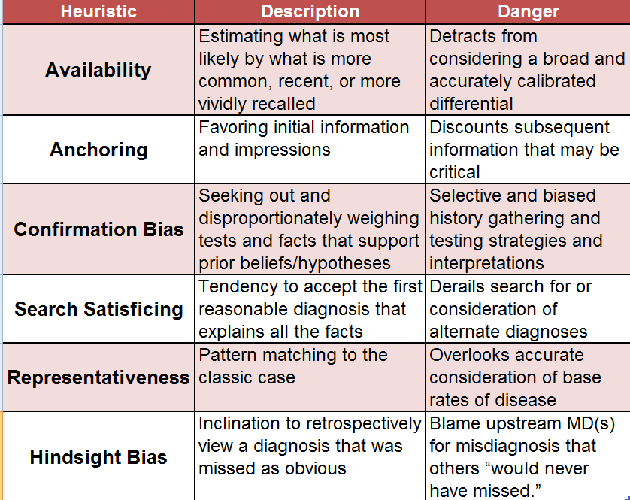
Schiff & Graber Diagnosis Errors in Acute Care Setting. Principles and Practice of Hospital Medicine McGraw Hill 2012

Slide 35
Diagnostic Risk
Safety Nets
Recognizing inherent uncertainties/risks, build in mitigation, protections, recovery structures and processes
Proactive, systematic follow-up, feedback via closed loop systems
Major role for HIT to hard-wire
  To automate, ensure reliability, ease burden on staff/memory, ensure loops closed and outliers visible

Slide 36
Principles for Leveraging, Learning, Lessening Diagnostic Error in Medicine
↓ Reliance on memory
New science of diagnostic uncertainty
Linkages Dx & Rx
Leverage HIT
Re-engineering diagnosis as a system
Diagnostician of future

Slide 38
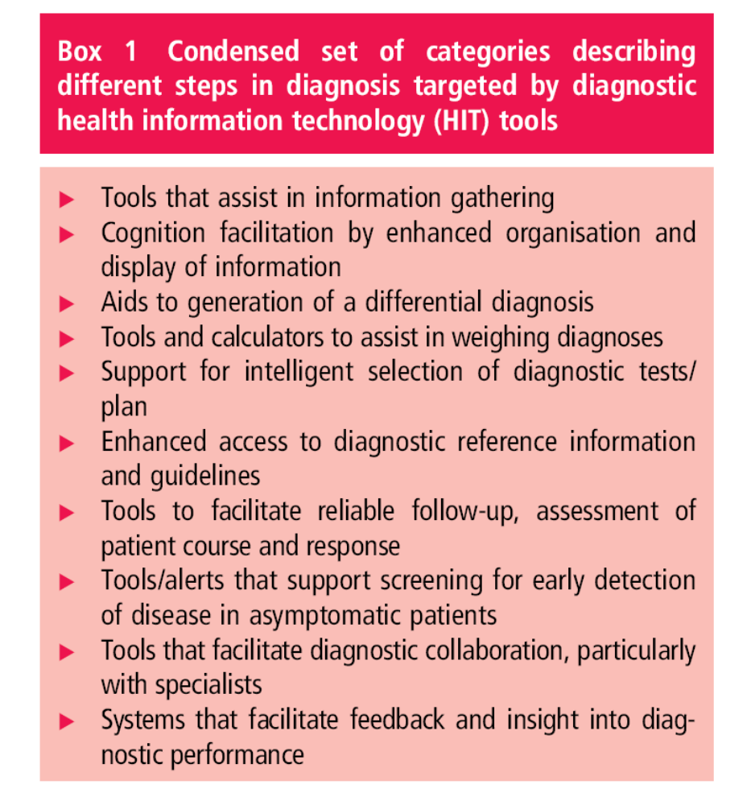
El-Kareh
Schiff
BMJ QS 2013

Slide 39
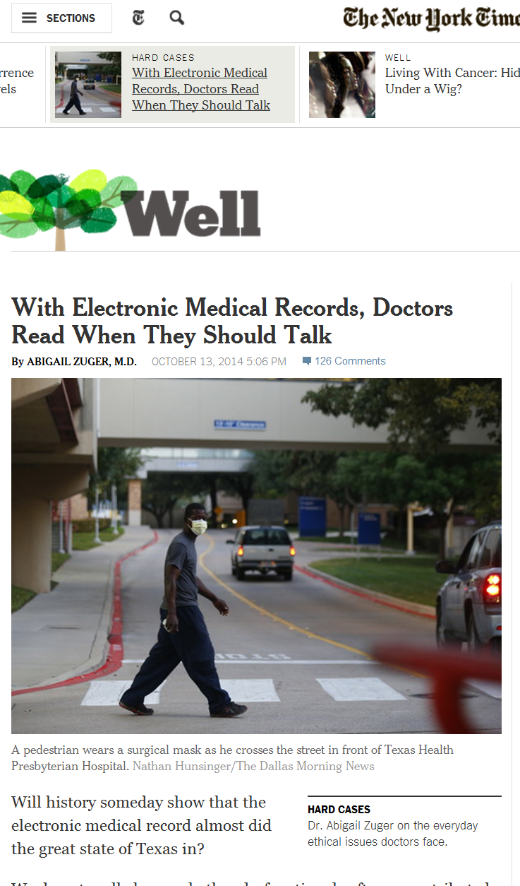


Slide 40
With Electronic Medical Records,
Doctors Read When They Should Talk
Abigail Zuger New York Times 10/13/2014
Will history someday show that the electronic medical record almost did the great state of Texas in?
We are in the middle of a simmering crisis in medical data management. Like computer servers everywhere, hospital servers store great masses of trivia mixed with valuable information and gross misinformation, all cut and pasted and endlessly reiterated
There is no time to dig and, even worse, no time to do what we were trained to do — slow down, go to the source, and start from the beginning.

Slide 41
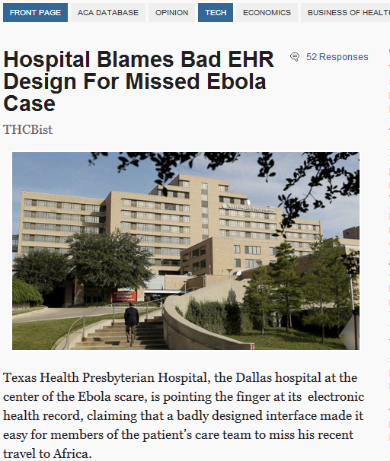

Slide 42
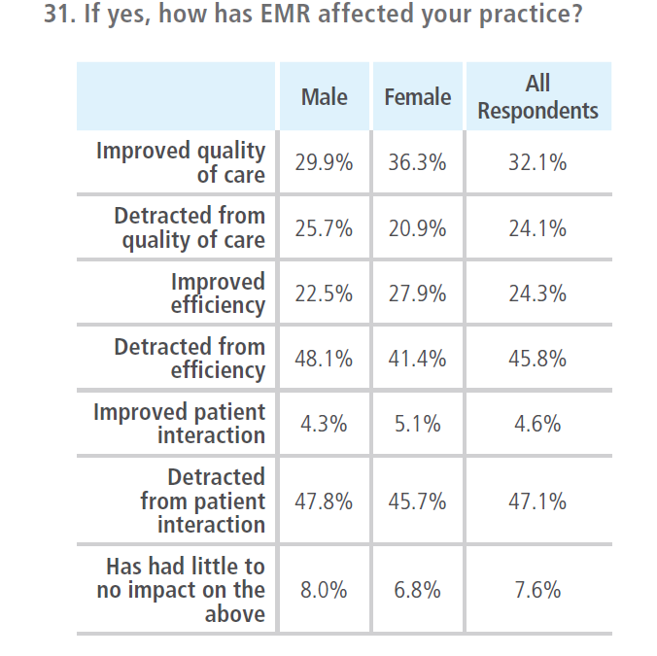
http://www.physiciansfoundation.org/uploads/default/2014_Physicians_Foundation_Biennial_Physician_Survey_Report.pdf

Slide 43
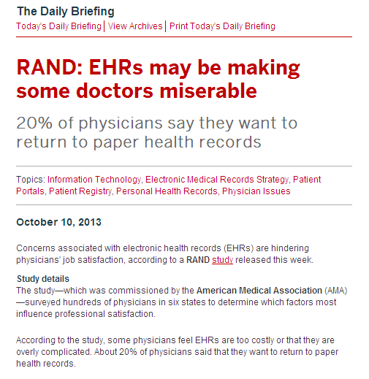

43

Slide 44
Priority to “rapidly improve EHR usabilty and functionality
44

Slide 45

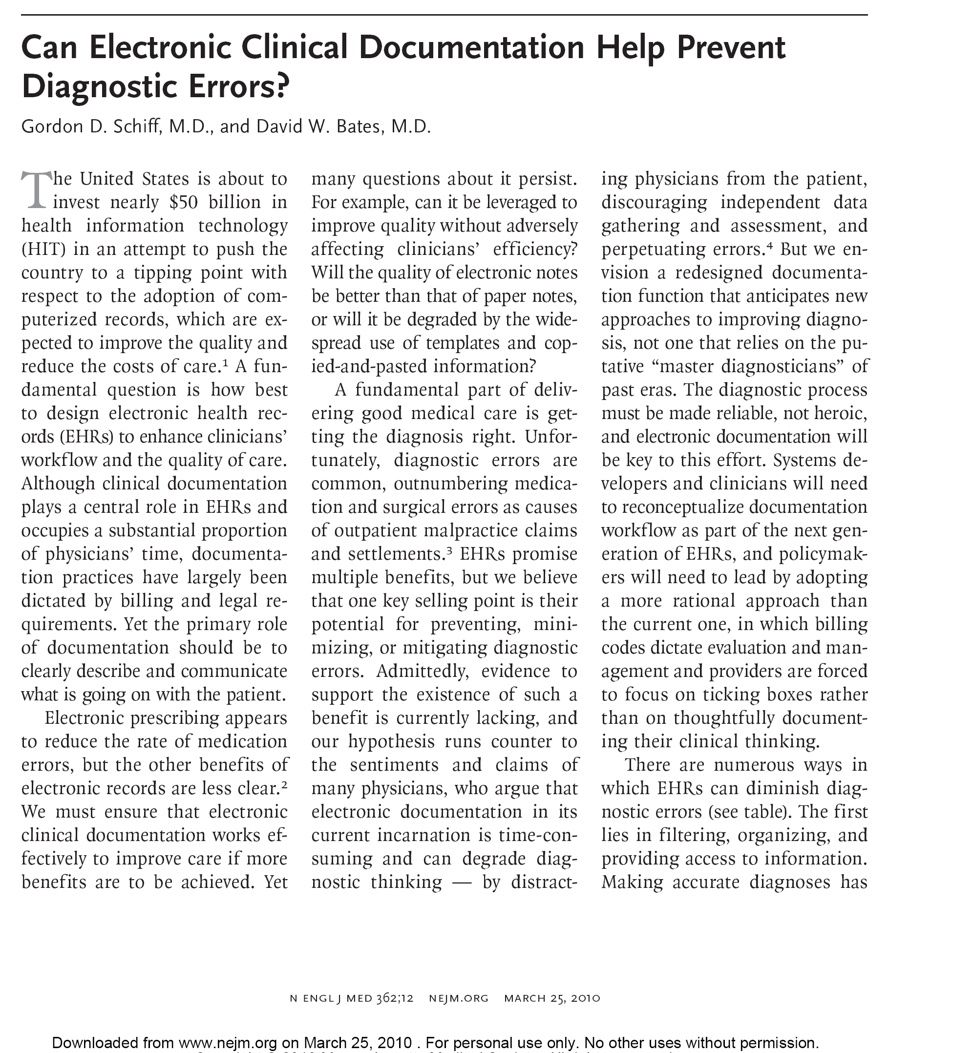

Slide 46
Role for Electronic Documentation | Goals and Features of Redesigned Systems
Providing access to information | Ensure ease, speed, and selectivity of information searches; aid cognition through aggregation, trending, contextual relevance, and minimizing of superfluous data.
Recording and sharing assessments | Provide a space for recording thoughtful, succinct assessments, differential diagnoses, contingencies, and unanswered questions; facilitate sharing and review of assessments by both patient and other clinicians.
Maintaining dynamic patient history | Carry forward information for recall, avoiding repetitive pt querying and recording while minimizing erroneous copying and pasting
Maintaining problem lists | Ensure that problem lists are integrated into workflow to allow for continuous updating.
Tracking medications | Record medications patient is actually taking, patient responses to medications, and adverse effects to avert misdiagnoses and ensure timely recognition of medication problems.
Tracking tests | Integrate management of diagnostic test results into note workflow to facilitate review, assessment, and responsive action as well as documentation of these steps.

Slide 47

Clinical Documentation
CYA

Slide 48

Canvass for
Your
Assessment
Van Gogh: Self-Portrait in Front of the Easel

Slide 49

-Differential Diagnosis
-Weighing Likelihoods
-Etiology
-Urgency
-Degree of
certainty
Canvass for
Your
Assessment

Slide 50
Role for Electronic Documentation | Goals and Features of Redesigned Systems
Ensuring coordination and continuity | Aggregate and integrate data from all care episodes and fragmented encounters to permit thoughtful synthesis.
Enabling follow-up | Facilitate patient education about potential red-flag symptoms; track follow-up.
Providing feedback | Automatically provide feedback to clinicians upstream, facilitating learning from outcomes of diagnostic decisions.
Providing prompts | Provide checklists to minimize reliance on memory and directed questioning to aid in diagnostic thoroughness and problem solving.
Providing placeholder for resumption of work | Delineate clearly in the record where clinician should resume work after interruption, preventing lapses in data collection and thought process.
Schiff & Bates NEJM 2010

Slide 51

Open Loop System
Schiff A J Med 2008
Notes:
51

Slide 52
Open Loop System
Water goes on the same time each day, regardless of whether it is raining or lawn is flooded
Schiff A J Med 2008
Notes:
52

Slide 53
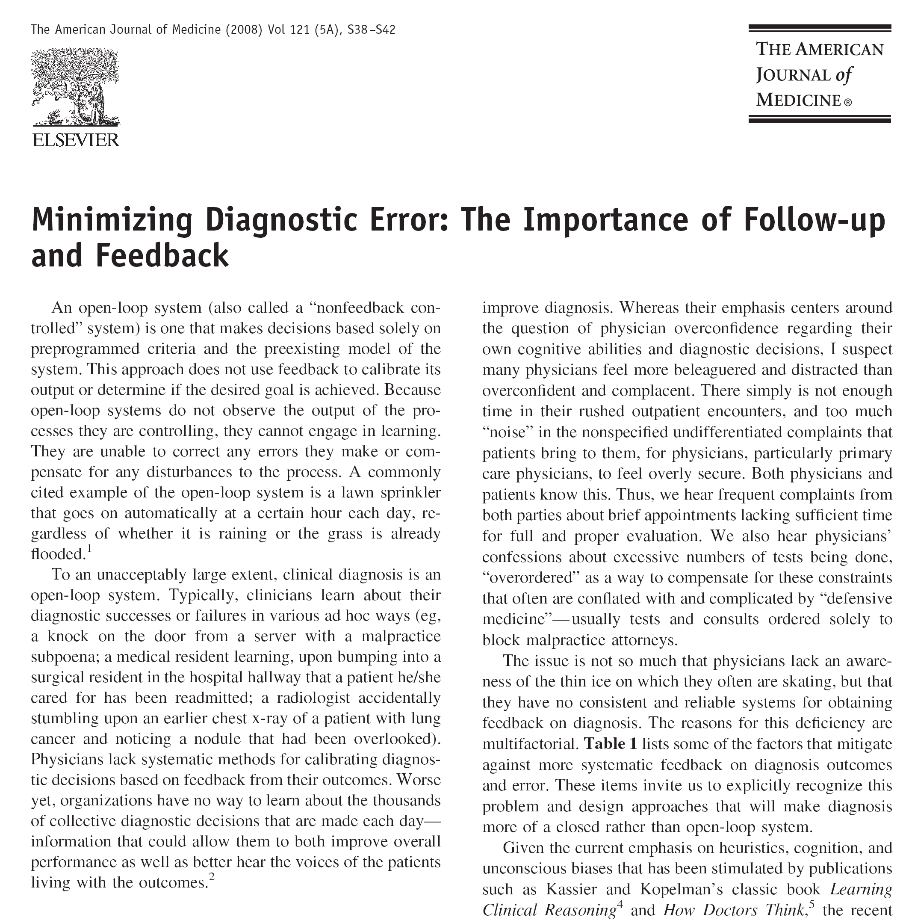

Slide 54

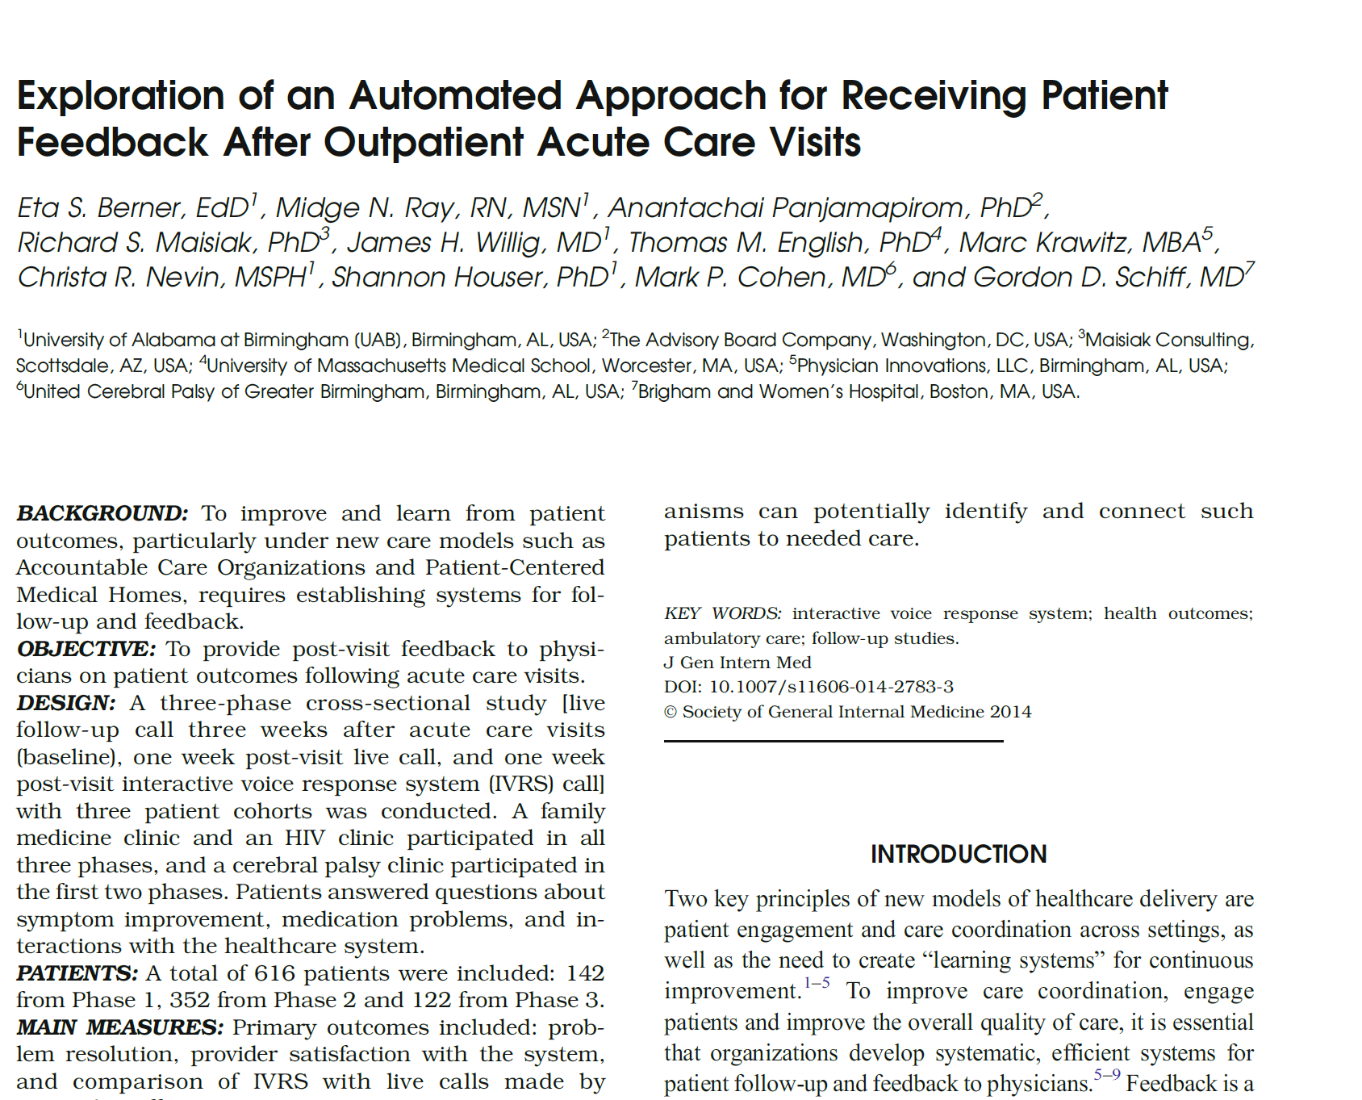

Slide 55
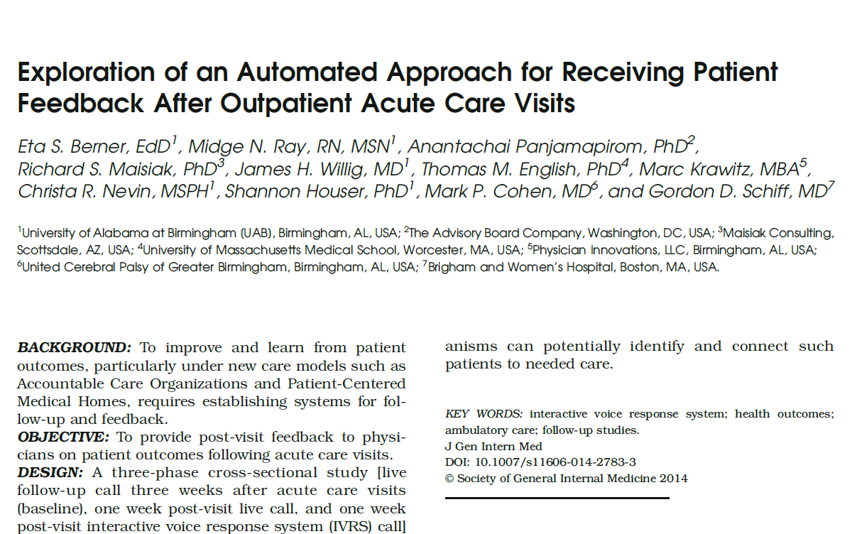
55/338 (16%) → not improved
of whom only 21 (38%)
had contacted any clinician

Slide 56
Feedback –Key Role in Safety
Structural commitment patient role to play
Embodies/conveys message: uncertainty, caring, reassurance, access if needed
Allows deployment of test of time, more conservative diagnosis
Enables differential diagnosis
Emphasizes that disease is dynamic
Reinforces culture of learning & improvement
Illustrates how much disease is self limited
Makes invisible missed diagnoses visible

Slide 57
Examples of Feedback Learning
Feeding back to upstream hospital
- spinal epidural abscess
IVR follow-up post urgent care visit
- UAB Berner project
Dedicated Dx Error M&M
Autopsy Feedback
- 7/32 MDs aware disseminated CMV
ED residents post admission tracking
Feedback to previous service
Tracking persistent mysteries
Chart correction by patients
Radiology/pathology
- systematic second reviews
2nd opinion cases
- Best Doctors dx changed
Linking lab and pharmacy data
- to find signal of errors (missed ↑ TSH)
Urgent care
- call back f/up systems
Malpractice
- knock on the door
57

Slide 58
Feedback- Challenges
Effort, time, support required
Discontinuities
Can convey non-reassuring message
Feedback fatigue
Non-response not always good predictor of misdiagnosis as multiple confounders
Tampering – form of availability bias

Slide 59
Diagnosis Essentials Checklist
1. Essential Data Elements - Elements of Hx, P.exam, tests data that should be reliably obtained for every pt presenting with given sx. In many situations can reliably be done w/ computer questionnaire.
2. Don’t miss diagnoses –critical dx can present w/ sx that are fatal or have serious consequences if not recognized and rx promptly. These dx should be considered in every patient with that symptom.
3. Red flag symptoms- sx or findings (e.g. back pain with new urinary incontinence in cancer patient) that may indicate serious condition & should lead to heightened suspicion/evaluation for don’t miss dx.
Schiff & Leape Acad Med 2012
Schiff BMJ Safety & Qual 2012

Slide 60
Fatigue Checklist (27 diagnoses)
Obstructive sleep apnea
♠Depression, anxiety
Deconditioning
*Drugs (beta blocker, clonidine, alcohol)
Chronic fatigue syndrome, fibromyalgia
♠*Infections, infectious mononucleosis, hepatitis, pneumonia, mastitis
♠Pregnancy
♠*Anemia
Vitamin D deficiency
♠Hypothyroidism, hyperthyroidism
♠Hypokalemia, hyponatremia
♠*Myocardial infarction
♠Celiac disease
♠Disturbance of calcium, phosphorus, magnesium
♠Polymyalgia rheumatica/Temporal arteritis
Parkinson disease
Hypogonadism
Myasthenia gravis
♠*Heart failure, myocarditis
Pulmonary, hepatic, renal failure
Restless legs syndrome
Multiple sclerosis
♠Carbon monoxide
♠Adrenal insufficiency, Addison’s disease
B12 deficiency
♠Botulism
Black widow spider bite
♠ Don’t miss
* Often missed
Prevalence
Ely Acad Med 2010

Slide 61
Diagnosis Essentials Checklist
4. Potential drug causes – meds that can cause the symptom. High % sx med side effects, yet infrequently considered.
5. Required referrals - When is specialist expertise or technology needed to adequately and safely evaluate the patient? Includes possible rare conditions that only specialists have sufficient experience or where required testing (biopsy or endoscopy)
6. Patient follow-up instructions and plan - Warnings that patients should receive regarding specific symptoms that should lead them to return or call. These should be in writing and include a time frame. (e.g. call if you develop rash or fever, or if you are not improved in 48 hours)
Schiff & Leape Acad Med 2012
Schiff BMJ Safety & Qual 2012

Slide 62
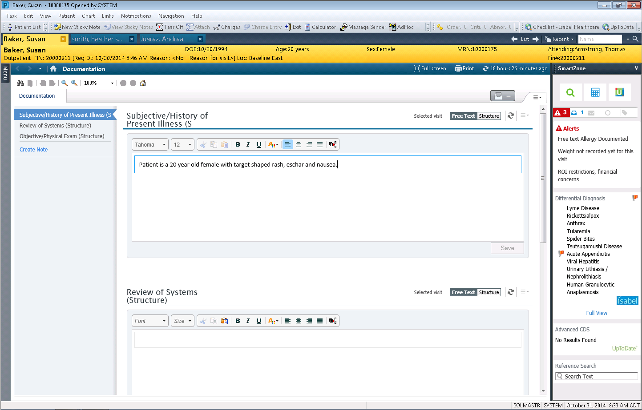
3rd generation Dx support
Cerner with Isabel integration

Slide 64
Role for Electronic Documentation | Goals and Features of Redesigned Systems
Calculating Bayesian probabilities | Embed calculator into notes to reduce errors and minimize biases in subjective estimation of diagnostic probabilities.
Providing access to information sources | Provide instant access to knowledge resources through context-specific “info buttons” triggered by keywords in notes that link user to relevant textbooks and guidelines.
Offering second opinion or consultation | Integrate immediate online or telephone access to consultants to answer questions related to referral triage, testing strategies, or definitive diagnostic assessments.
Increasing efficiency | More thoughtful design, workflow integration, easing and distribution of documentation burden could speed up charting, freeing time for communication and cognition.
Schiff & Bates NEJM 2010

Slide 65
Role for Patient
In Minimizing and Preventing Diagnosis Error and Delay
Push for timely access
Reliable follow-up, continuity
Keen observer, reporter sx
Proactive on test results
Sharing hunches
Curiously reading on own
Meticulously adhering w/ empiric trial regimens
Active as co-investigator
Being patient: time & tests
Recruiting family for support
Respecting limits on staff time, society resources
Agreeing to disagree
Help in building, maintaining trust and communication
Getting involved with patient organizations

Slide 66
Role for Patient
In Minimizing and Preventing Diagnosis Error and Delay
Push for timely access
Reliable follow-up, continuity
Keen observer, reporter sx
Proactive on test results
Sharing hunches
Curiously reading on own
Meticulously adhering w/ empiric trial regimens
Active as co-investigator
Being patient: time & tests
Recruiting family for support
Respecting limits on staff time, society resources
Agreeing to disagree
Help in building, maintaining trust and communication
Getting involved with patient organizations
Key question is:
What will it take at the provider and institutional end
to support these roles and help them flourish?

Slide 67
Ricardo Levins Morales Art Studio
67

